Slide 1

Smart Restaurant Ordering
& Kitchen Display System
Database Systems Engineering and Distributed Backend Development
Team 25 • Section 12 • CSIT
Hitesh Suthar = 2520090078 | B. Vasudeva = 2520090136 | V. Nikith Chowdary = 2520090219
PROJECT VIEW = 2

Slide 2
Introduction
Traditional restaurant ordering mainly depends on communication between customers, waiters, and kitchen staff.
Manual ordering can result in:
Incorrect orders
Delays in order processing
Difficulty in tracking orders
Challenges in managing restaurant operations
Our project introduces a digital restaurant ordering and kitchen management system to make the process faster, simpler, and more efficient.
2

Slide 3
Abstract
Smart Restaurant Ordering & Kitchen Display System provides a digital solution for restaurant ordering and kitchen management.
Customers scan a QR code at their table.
They access the digital menu using their mobile device.
Customers select food items, quantities, and add them to a cart.
Orders are stored in the database and displayed on the kitchen dashboard.
Kitchen staff can update orders through:
Pending → Preparing → Ready → Delivered
Socket.io enables real-time order and status updates.
3

Slide 4
Objectives
Reduce manual errors in restaurant ordering.
Provide a simple QR-based ordering system.
Enable customers to place orders directly.
Store and manage restaurant data efficiently.
Provide a real-time kitchen order dashboard.
Improve communication between customers and kitchen staff.
Automate bill calculation and invoice generation.
Provide an efficient and user-friendly restaurant management solution
4

Slide 5
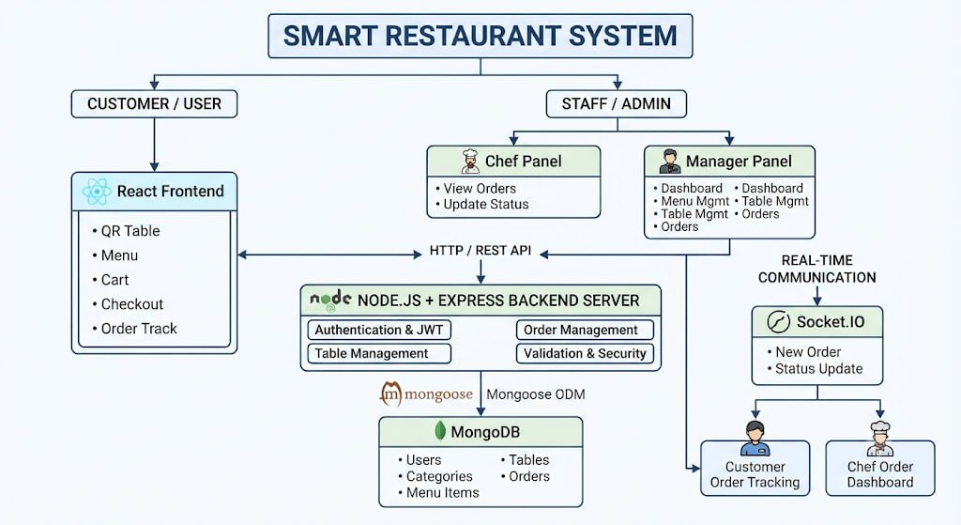
v
SYSTEM ARCHITECTURE
Proposed System – Working Flow
1
Scan QR
2
Digital Menu
3
Cart & Order
4
Database
Customer scans the table QR code.
Browse food items and quantities.
Add items and place the order.
Order is stored in MongoDB.
5
Kitchen
6
Live Status
7
Billing
Order appears on the kitchen dashboard.
Status updates via Socket.io.
Bill is calculated and invoice generated.
5

Slide 6
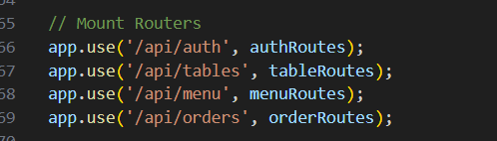
REST API
/api/auth → Handles user registration, login, logout, and authentication.
/api/tables → Handles restaurant table operations, such as viewing or managing tables.
/api/menu → Handles food menu operations, such as viewing, adding, or updating menu items.
/api/orders → Handles customer orders, such as creating, viewing, and updating orders.

Slide 7
Admin Module
The admin module allows restaurant administrators to manage:
Menu items
Restaurant tables
Customer orders
Basic sales information
Restaurant-related application data
The system also supports automatic bill calculation and printable invoices
7

Slide 8
Software / Technologies Used
React.js — Frontend
Node.js — Backend
Express.js — REST API / Backend
MongoDB — Database
Socket.io — Real-time communication
JavaScript — Application logic
HTML5 & CSS3 — Web structure & styling
REST APIs — Client-server communication
QR Code Generation — Table-based ordering
Git / GitHub — Version control
Antigravity — Listed tool/platform
8

Slide 9
Expected Outcomes
Minimize errors caused by manual order taking.
Reduce delays in order processing.
Improve order tracking and kitchen coordination.
Provide a convenient digital ordering experience.
Centralize restaurant data in a database.
Automate billing and invoice generation.
Improve overall restaurant management efficiency.
9

Slide 10
Conclusion
The Smart Restaurant Ordering & Kitchen Display System digitizes restaurant ordering and kitchen management using QR codes, a digital menu, database storage, and real-time communication.
The system aims to reduce manual errors, improve order processing, and provide an efficient, user-friendly digital restaurant management solution.
11

